Slide 1
Climate Change
CAUSES

Slide 2
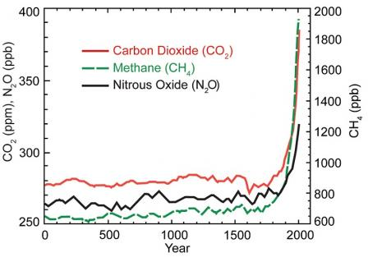
Greenhouse Gases
Greenhouse gases build up in the Earth’s atmosphere. They let the short radiation waves enter the Earth’s atmosphere without problem, but they trap the slower infrared rays that try to exit the atmosphere.
Many of these gases occur naturally, but human activity is increasing the concentrations of some of them in the atmosphere, including: carbon dioxide, methane and nitrous oxide.
Source: Environmental Protection Agency website: https://19january2017snapshot.epa.gov/climatechange_.html

Slide 3
Coal, Oil, and Natural Gas (CO₂)
In 2014, CO₂ accounted for about 80.9% of all U.S. greenhouse gas emissions from human activities.
The main human activity that emits CO₂ is the combustion of fossil fuels (coal, natural gas, and oil) for energy and transportation, although certain industrial processes and land-use changes also emit CO₂.
While CO₂ emissions come from a variety of natural sources, human-related emissions are responsible for the increase that has occurred in the atmosphere since the industrial revolution.
Source: Environmental Protection Agency website: https://19january2017snapshot.epa.gov/climatechange_.html

Slide 4
Livestock
Although methane (CH₄) accounts for only 10% of emissions, each molecule is about 30x more harmful than a CO₂ molecule.
Domestic livestock such as cattle, buffalo, sheep, goats, and camels produce large amounts of CH₄ as part of their normal digestive process.
Also, when animals' manure is stored or managed in lagoons or holding tanks, CH₄ is produced. Because humans raise these animals for food, the emissions are considered human-related. Globally, the Agriculture sector is the primary source of CH₄ emissions.
Cow wearing a “methane collecting” backpack, which captures and measures methane emissions.
Source: Environmental Protection Agency website: https://19january2017snapshot.epa.gov/climatechange_.html

Slide 5
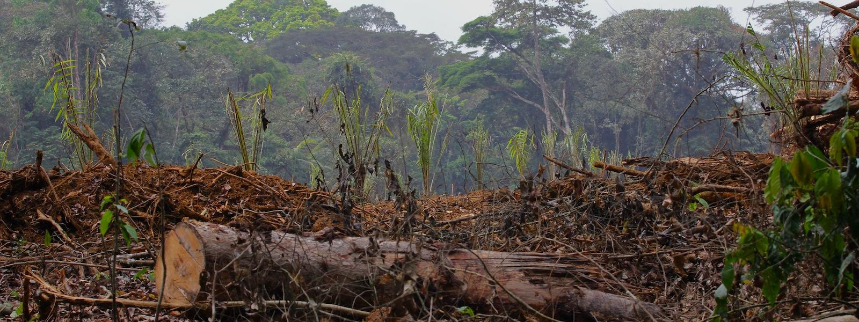
Deforestation
In the United States, forests occupy approximately 740 million acres, about one third of the country's total land area. America's forests provide many benefits and services to society, including clean water and air, recreation, wildlife habitat, carbon storage, climate regulation, and a variety of forest products.
Forests serve as carbon sinks. Trees use the atmospheric carbon dioxide and use it to build their bodies, storing it. As humans burn and destroy forests for industrial and agricultural purposes, not only are we releasing more carbon into the air, but less is being pulled out.
Source: Environmental Protection Agency website: https://19january2017snapshot.epa.gov/climatechange_.html

Slide 6
Landfills
Traditional waste management techniques account for as much as 5% of greenhouse gas emissions. As the stuff we throw away breaks down, it leaks methane back into the air.
Approximately 42 percent of U.S. greenhouse gas emissions are associated with the energy used to produce, process, transport, and dispose of the food we eat and the goods we use.
Source: Environmental Protection Agency website: https://19january2017snapshot.epa.gov/climatechange_.html

Slide 7
Human Population
As the human population continues to grow at an exponential pace, the amount of resources we use (coal, oil, gas, food, trees, etc.) continues to rise.
The more the world's population rises, the greater the strain on dwindling resources and the greater the impact on the environment.
Source: Environmental Protection Agency website: https://19january2017snapshot.epa.gov/climatechange_.html

Slide 8
Climate Change
EFFECTS

Slide 9
Global Temperature Rise
Earth's average surface temperature has increased by more than 1.5°F since the 1880s. Two-thirds of the warming has occurred in the last 40 years, at a rate of roughly 0.3°F – 0.4°F per decade. Average temperatures have risen across the contiguous 48 states since 1901, with an increased rate of warming over the past 30 years.
These maps show temperatures across the world in the 1880s (left) and the 1980s (right). Blue colors represent cooler temperatures compared with the average temperatures from 1951 to 1980, and red colors represent warmer temperatures compared to this average.
Source: Environmental Protection Agency website: https://19january2017snapshot.epa.gov/climatechange_.html

Slide 10
Sea Levels Rise
Approximately 10% of the world’s population lives in low-lying coastal areas and 2/3 of the world’s cities are at risk - especially as more people flock to cities.
Climate change threatens coastal areas, which are already stressed by human activity, pollution, invasive species, and storms.
Sea level rise could erode and inundate coastal ecosystems and eliminate wetlands.
Since 1901, the global sea level has risen approximately 8 inches.
Source: Environmental Protection Agency website: https://19january2017snapshot.epa.gov/climatechange_.html

Slide 11
Extreme Weather
There have been changes in some types of extreme weather events in the United States over the last several decades, including more intense and frequent heat waves, less frequent and intense cold waves, and regional changes in floods, droughts, and wildfires. This rise in extreme weather events fits a pattern you can expect with a warming planet.
Coastal areas are also vulnerable to increases in the intensity of storm surge and heavy precipitation. Storm surges flood low-lying areas, damage property, disrupt transportation systems, destroy habitat, and threaten human health and safety.
Source: Environmental Protection Agency website: https://19january2017snapshot.epa.gov/climatechange_.html

Slide 12
Economy
Net expenditure in annual heating and cooling could increase by 10% ($26 billion) with a 4.5°F warming by the end of the century, and by 22% ($57 billion) with a warming of 9.0°F
A large portion of U.S. energy infrastructure is located in coastal areas and therefore sensitive to sea level rise and storm surge. For example, fuel ports and the generation and transmission lines that bring electricity to major urban coastal centers are at risk.
Changes in the frequency and severity of storms and other extreme events may also damage energy infrastructure, resulting in energy shortages that harm the economy and disrupt peoples’ daily lives.
The number of cooling (or heating) "degree days" refers to the sum of the number of degrees that each day's average temperature is hotter (or colder) than 65°F over the course of a year. Source: USGCRP (2009)
Source: Environmental Protection Agency website: https://19january2017snapshot.epa.gov/climatechange_.html

Slide 13
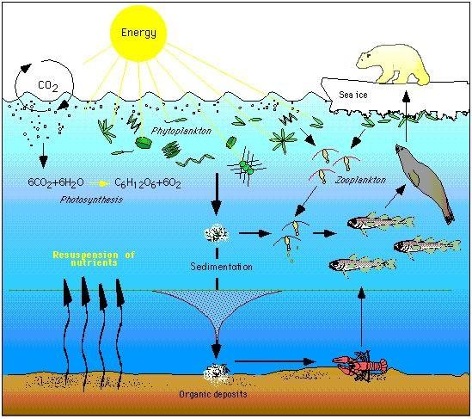
Impact on Ecosystems
Higher sea surface temperatures increase the risks of coral bleaching, which can lead to coral death and the loss of critical habitat for other species.
Warming may force species to migrate to higher latitudes or higher elevations where temperatures are more conducive to their survival. Similarly, as sea level rises, saltwater intrusion into a freshwater system may force some key species to relocate or die, thus removing predators or prey that are critical in the existing food chain.
The impact of climate change on a particular species can ripple through a food web and affect a wide range of other organisms.
Source: Environmental Protection Agency website: https://19january2017snapshot.epa.gov/climatechange_.html

Slide 14
Human Health
Climate change threatens human health, including mental health, and access to clean air, safe drinking water, nutritious food, and shelter.

Slide 15
Climate Change
SOLUTIONS

Slide 16
Renewable Energy
Focusing on renewable energy would shift the emphasis away from coal and oil. It includes investing more into solar power, wind power, bio-fuels, and geothermal energy at the industrial, consumer, and personal levels.
Benefits include
Reduced air pollution and greenhouse gas emissions
Lower consumer energy bills
Enhanced state and local economic development and job creation
Improved energy system reliability and security
Source: Environmental Protection Agency website: https://19january2017snapshot.epa.gov/climatechange_.html

Slide 17
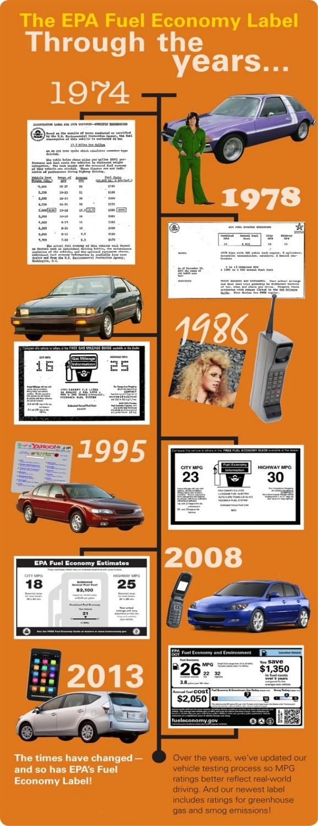
Upgraded Transportation
As the world heads toward two billion vehicles, making sure that these cars emit less pollution—both smog-forming nitrogen oxides and heat-trapping carbon dioxide—will be crucial, whether it is accomplished via more efficient internal combustion engines or better hybrids.
The EPA and Dept. of Transportation goals
Cut 6 billion metric tons of emissions over vehicle lifetime sold in model years 2012-2025
Nearly double the fuel efficiency while protecting consumer choice; and
Reduce America’s dependence on oil and provide significant savings for consumers at the pump.
Source: Environmental Protection Agency website: https://19january2017snapshot.epa.gov/climatechange_.html

Slide 18
Infrastructure Upgrade
Buildings worldwide contribute around one third of all greenhouse gas emissions (43 percent in the U.S. alone), even though investing in thicker insulation and other cost-effective, temperature-regulating steps can save money in the long run.
Electric grids are at capacity or overloaded, but power demands continue to rise. And bad roads can lower the fuel economy of even the most efficient vehicle. Investing in new infrastructure, or radically upgrading existing highways and transmission lines, would help cut greenhouse gas emissions and drive economic growth in developing countries.
Source: Environmental Protection Agency website: https://19january2017snapshot.epa.gov/climatechange_.html

Slide 19
Sustainable Agriculture
Everyone plays a role in creating a sustainable food system.
Corn grown in the U.S. requires barrels of oil for the fertilizer to grow it and the diesel fuel to harvest and transport it. Some grocery stores stock organic produce that do not require such fertilizers, but it is often shipped from halfway across the globe.
Consumers can play a critical role in creating a sustainable food system. Through their purchases, they send strong messages to producers, retailers and others in the system about what they think is important.
Source: UC Davis Agricultural Sustainability Institute http://asi.ucdavis.edu/programs/sarep/about/what-is-sustainable-agriculture

Slide 20
Reusing & Recycling
Reusing or recycling old materials means that no new materials are being used. No new trees are being cut down, no new oil is being used, etc.
Improved paper recycling and forest management—balancing the amount of wood taken out with the amount of new trees growing—could quickly eliminate a significant chunk of emissions.
Think twice before you buy new items. You can find gently used clothes, furniture… almost anything if you look (and for a lot less money)!
Source: Environmental Protection Agency website: https://19january2017snapshot.epa.gov/climatechange_.html

