Slide 1
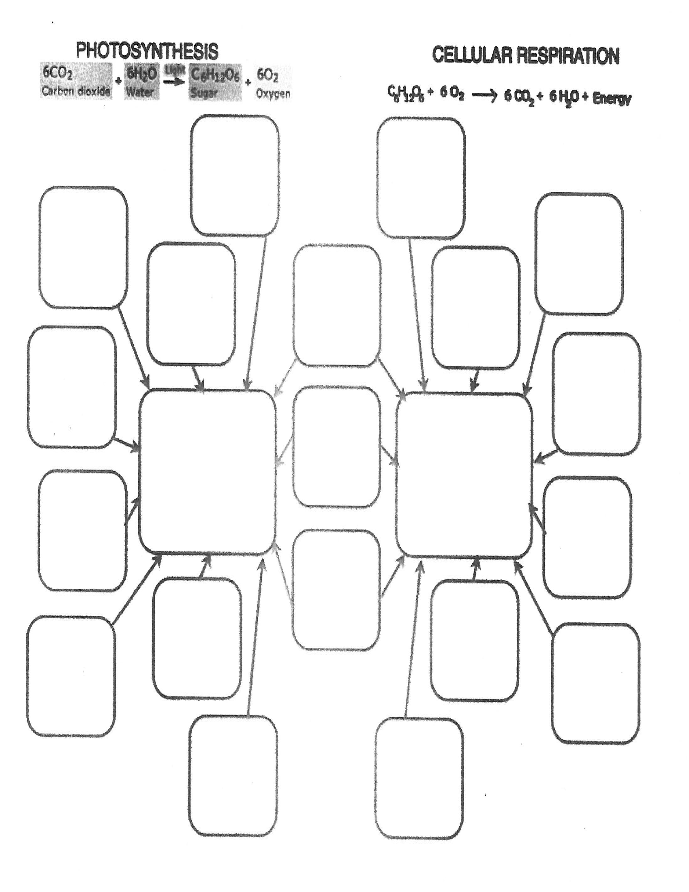
Photosynthesis
Cellular
Respiration

Slide 2
Fill in the chart with the following phrases.
Occurs only
in the presence
of chlorophyll
Energy from
the sun is
stored in
Chloroplasts
Produces
Glucose
and Oxygen
Uses the products of photosynthesis
Goes on in
plants and
animals
Goes on
only in
plants
Oxygen
released through
the stoma
Beneficial to
Both plants
and animals
Occurs in
the
Mitochondria
Produces carbon
dioxide, water,
and energy (ATP
Energy (Glucose)
from
photosynthesis
is released
Occurs when
glucose is made
or taken in
Contribute to
the oxygen and
carbon dioxide
cycles
Food is
made
Carbon Dioxide
is taken in
through the
stoma
Oxygen and
glucose are
taken in
Occurs throughout
the plant, mostly
in the chloroplasts
Food is
broken
down
The ingredients
of one process
are the products
of the other

