Slide 1
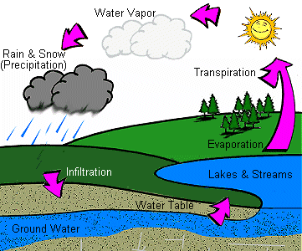
Water cycle
Definition: The continuous movement of water from the ocean to the atmosphere to the land and back to the ocean.
The water cycle, also known as the hydrologic cycle or the H2O cycle, describes the continuous movement of water on, above and below the surface of the Earth.

Slide 2
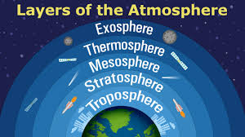
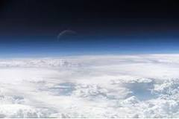
Atmosphere
Definition: The layer of gas that surrounds Earth. It is often called air
Other planets, and some of their larger moons, also have atmospheres. The atmosphere consists of several different gases. The gases are held close to Earth by a force called gravity.

Slide 3
Evaporation
Definition: the process by which surface water becomes water vapor in the atmosphere.
This is a type of vaporization of a liquid that occurs from the surface of a liquid.
Evaporation is an essential part of the water cycle. The sun (solar energy) drives evaporation of water from oceans, lakes, moisture in the soil, and other sources of water. Evaporation of water occurs when the surface of the liquid is exposed, allowing molecules to escape and form water vapor; this vapor can then rise up and form clouds.

Slide 4
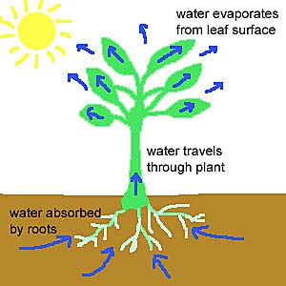
Transpiration
Definition: the process by which water from inside a plant exits through the stomata, changes to gas, and is released to the atmosphere.
Transpiration is essentially evaporation of water from plant leaves.

Slide 5
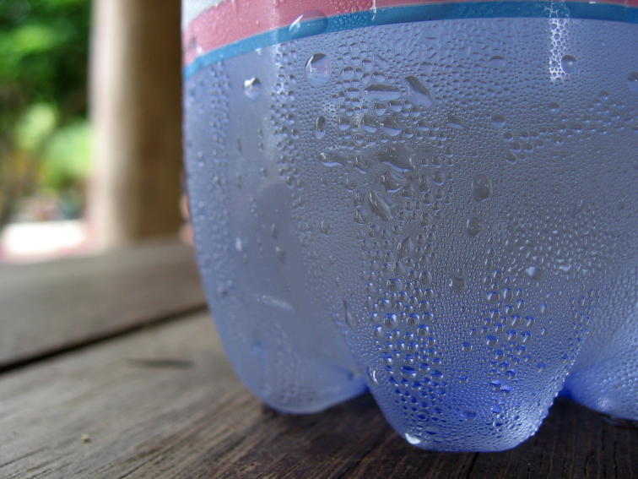
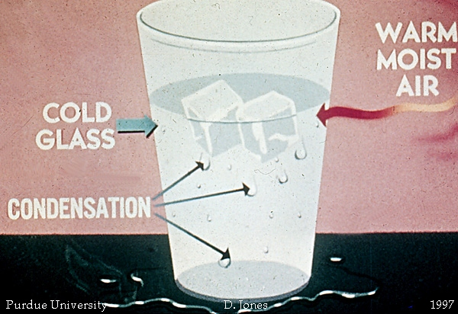
Condensation
Definition: the change water from gas phase into liquid phase, and is the reverse of vaporization.
Water that collects as droplets on a cold surface when humid air is in contact with it.

Slide 6
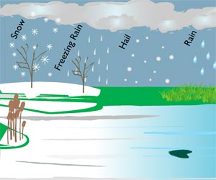
Precipitation
Definition: Any form of water that falls to the Earth’s surface from the clouds (in the sky).

Slide 7
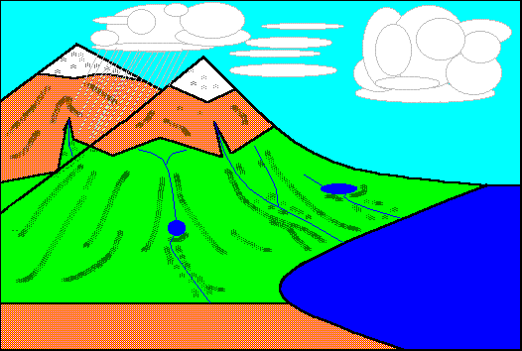
Runoff
Definition: The flow of excess water to lower elevations on Earth.
This happens after the soil has been completely filled with water (saturated).
This is a major component of the water cycle, and the primary agent in water erosion.

Slide 8
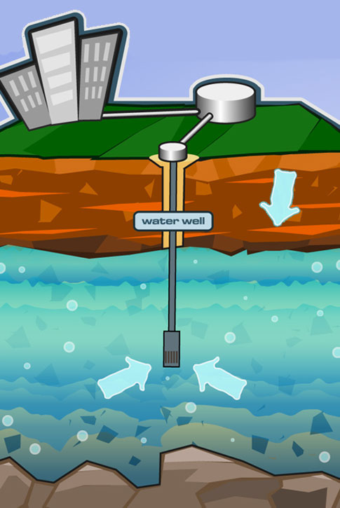
Groundwater
Definition: Groundwater is the water located beneath the earth's surface in soil pore spaces and in the fractures of rock formations.

Slide 9
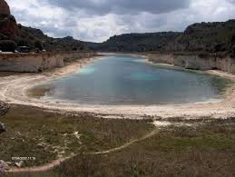
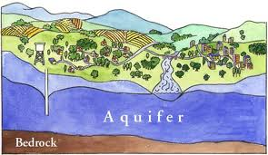
Aquifer
Definition: A body of rock or sediment that stores water and allows the flow of groundwater.

Slide 10
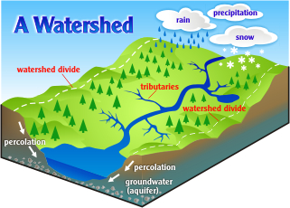
Watershed
Definition: An area of land where surface water from precipitation converges to a single point at a lower elevation
This usually is the exit of the basin, where the waters join another water body, such as a river, lake, reservoir, estuary, wetland, sea, or ocean.

Slide 11
Infiltration
Definition: the process by which water on Earth’s surface enters the soil.

Slide 12
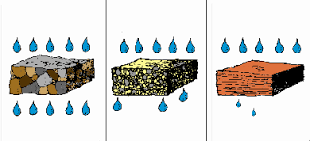
Permeability
Definition: allows liquid to pass through a substance
Example: water passes through soil and into an underground watershed

Slide 13
Porosity
Definition: when a material has spaces in between the particles that water can fill

Slide 14
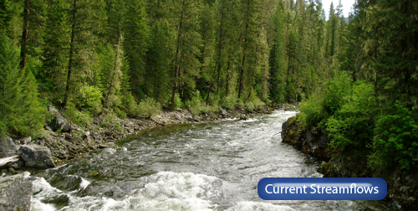
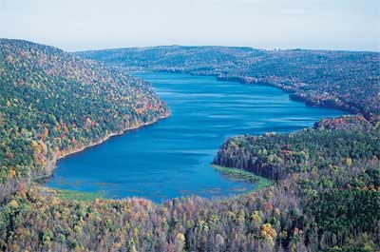
Surface water
Definition: Water on the surface of the planet such as in a stream, river, lake, wetland, or ocean.
It can be contrasted with groundwater and atmospheric water.

